Slide 1

Application of Asphaltene Deposition Tool (ADEPT) Simulator to Field Cases
Yi Chen, Anju Kurup, Walter Chapman
Department of Chemical & Biomolecular Engineering, Rice University
Houston, April 29 2013

Slide 2
Outline
Introduction
Asphaltene deposition issue
The ADEPT simulator and application procedure
Field case studies
Summary

Slide 3
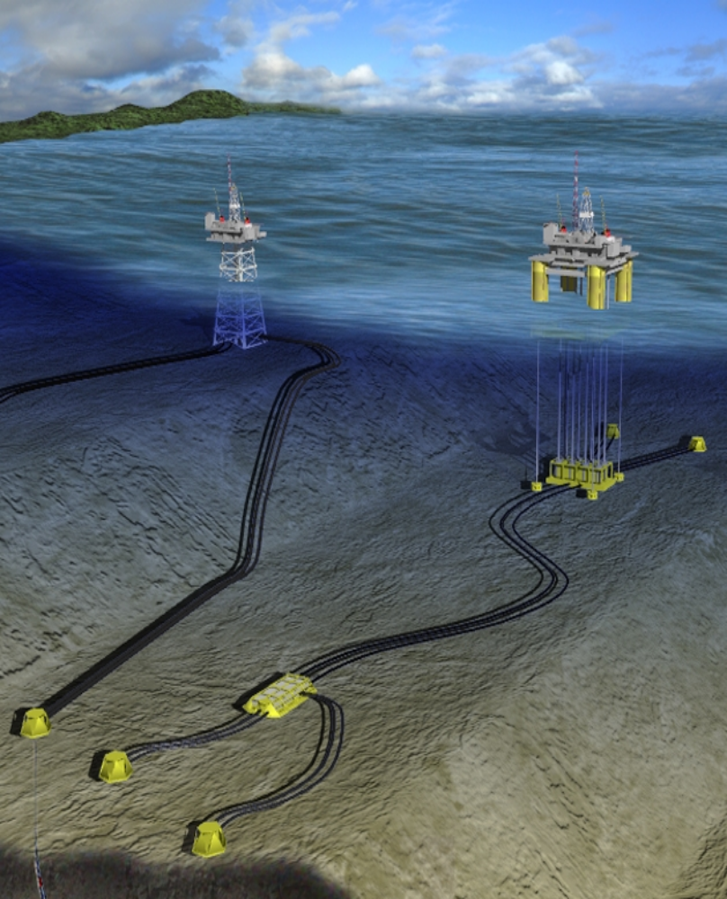
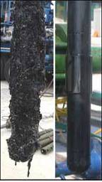
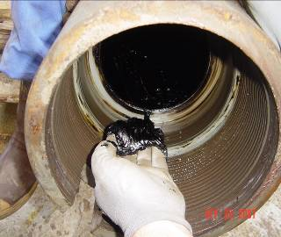
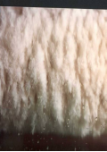


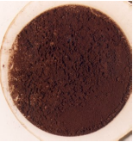

Asphaltene issue in flow assurance
Flow Assurance Prediction – Operator’s Savings:
  Intervention cost to remove solids: ~ 300K/well-dry tree, $3,500K / well – wet tree.
  Loosing the well: ~ $50,000K to replace the well with a side track.
  Losses due to downtime: ~ $ 700K /day (for prod. of 7,000bbls/day)

Slide 4
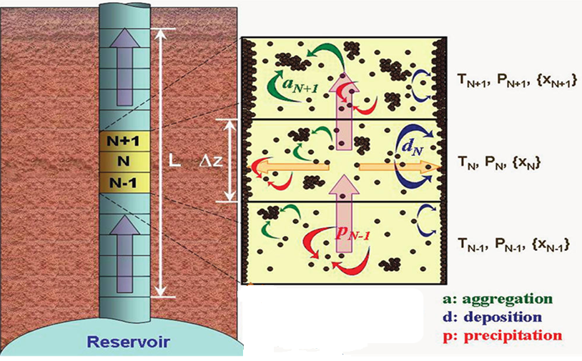
Deposition mechanism
advection
diffusion

Slide 5
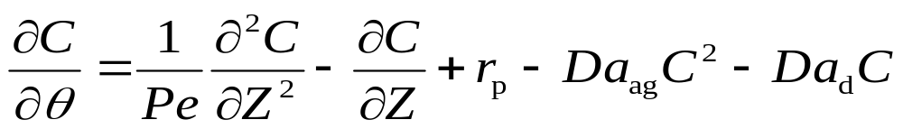
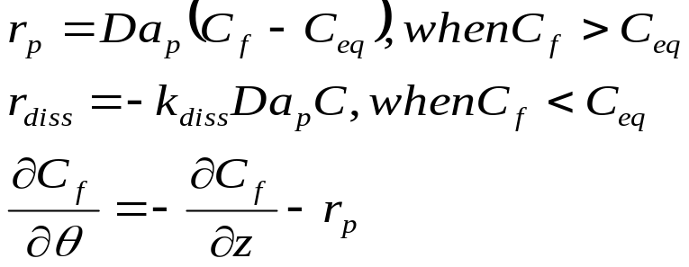
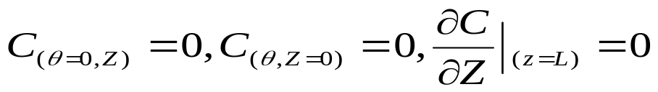
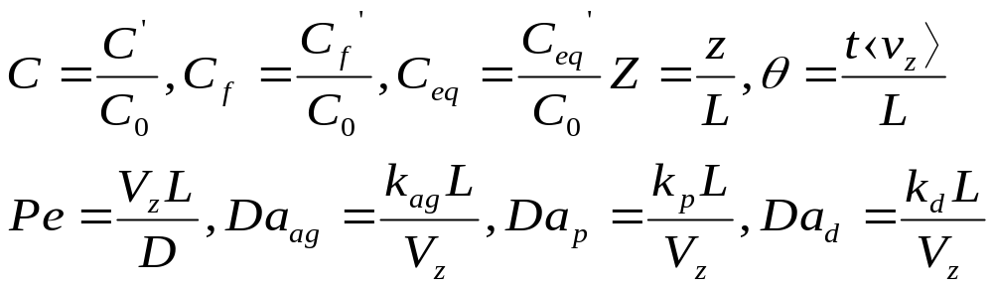
Mathematical model
Precipitation &
Re-dissolution kinetics:
Initial & boundary condition:
Dimensionless parameters:
Kurup, A.S. et al., Energy & Fuels. 2011, 25, 4506–4516

Slide 6
ADEPT simulator structure
Composition,
Liquid density,
Bubble point,
GOR, AOP, SARA
Asphaltene instability,
C_{eq}
Thermodynamic module
P-T profile in wellbore/pipeline
C_{eq}
Deposition
profile,
Thickness,
Pressure drop
Deposition
module
Kinetic parameters
Operational conditions
AOP--- Asphaltene onset pressure
C_{eq} --- Asphaltene equilibrium concentration

Slide 7
Thermodynamic modeling
Fluid composition, GOR, SARA
① Characterization / Recombination
MW & mass percentages of all (Pseudo-) components
②Tuning parameters to match P_{b}, liquid density, AOP
Appropriate Parameters
③Phase behavior prediction
Asphaltene instability
④ C_{eq} calculation with P-T profile input
Deposition module
Asphaltene equilibrium concentration, C_{eq}

Slide 8
Deposition modeling
Thermodynamic module
The asphaltene precipitated amounts
⑤ determine k_{p} & k_{ag} using reaction model
The kinetic constants of precipitation and aggregation
⑥fitting k_{d(cap)} to reproduce capillary deposition flux
The kinetic constant of deposition in capillary-scale
⑦scaling up of k_{d(cap)} to k*_{d}
The kinetic constant of deposition in field-scale
⑧input C_{eq} , k_{p} , k_{ag} , k*_{d} , operational conditions
Asphaltene deposition flux, thickness, pressure drop

Slide 9
field case 1

Slide 10
Deepwater Gulf of Mexico wellbore
  Wellbore pressure loss is approximately 10 psi per day in the first several weeks after wellbore wash;
  GOR decreases 60 ScF / STB over 4 months;
  GOR increases with gas injection;
  GOR sensitivity analysis is needed.

Slide 11
Phase behavior prediction(wellbore)
PC-SAFT EoS (VLXE / Multiflash / PVTsim)

Slide 12
Phase behavior prediction(wellbore)
GOR
GOR
Notes:
.

Slide 13
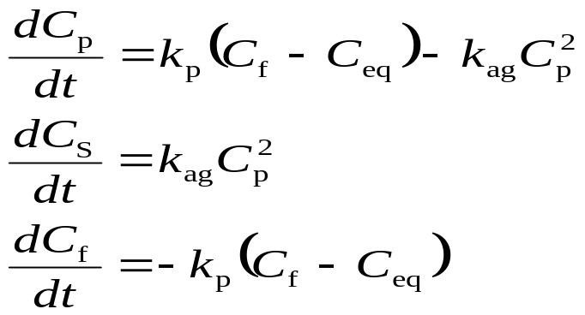
Extract k_{p} & k_{ag}
Batch experimental results from NMT
Aging Time (hour) | Precipitate amount (g)
0.166667 | 0.0132
0.333333 | 0.0165
0.5 | 0.0169
2 | 0.0167
4 | 0.0172
7.5 | 0.0187
12 | 0.0182
24 | 0.02
k_{p} / s⁻¹ | 2.5×10⁻²
k_{ag} / s⁻¹ | 1.7×10⁻³

Slide 14
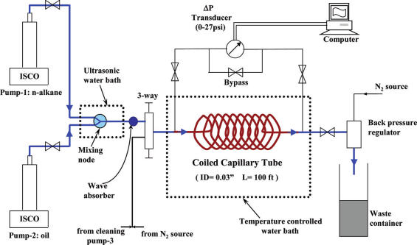
Capillary deposition test
Wang, J. X., et al., Dispersion Sci. Technol. 2004, 25, 287–298.

Slide 15
Fitting k_{d(cap)}
Expt
Simulation with fitted k_{d (cap)}
k_{d(cap)} = 2.11×10⁻³ s⁻¹
Fitting k_{d (cap)} to make the peak of deposition flux curve predicted match the experimental observation.

Slide 16
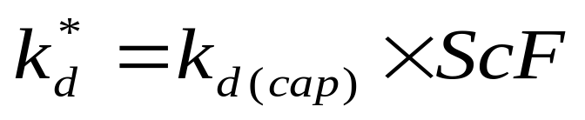
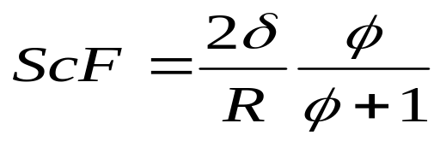
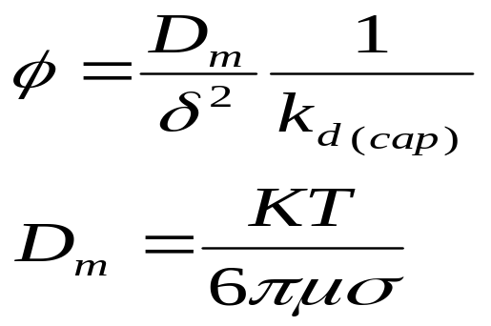

Scale up k_{d(cap)} to k*_{d}
k_{d (cap)}
k*_{d(mom)} = 4.31×10⁻⁶ s⁻¹
Kurup, A.S. et al., Energy & Fuels. 2012, 26 (9), pp 5702–5710

Slide 17
Deposition flux prediction (wellbore)
I
II
III
Aggregation
Flow in
Precipitated particles
Flow out
Re-dissolution starts
Deposition
CF-CEQ = 0

Slide 18
Deposit thickness prediction (wellbore)
14 days

Slide 19
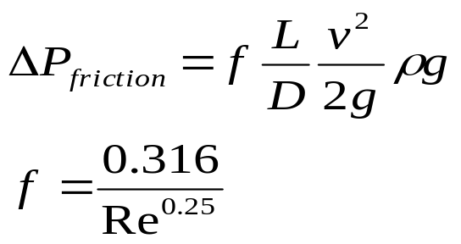
Frictional pressure drop (wellbore)
GOR SCF/STB | Frictional pressure drop Psi /day
549 | 9.45
669 | 10.10
1000 | 10.89
≈ 10 Psi / day (Based on 14 days)

Slide 20
field case 2

Slide 21
Field information (pipeline)
Pipeline | Gulf of Mexico
Pressure | 5,284 psi
Temperature | 177 ⁰F
Flow rate | 13482 bbl/day
Diameter | 5.137 inch 4.881 inch
length | 52389 ft
Asphaltene problem is reported.
The total pressure drop in the first 28 days is about 648 psi.
The asphaltene deposition situation must be estimated.

Slide 22
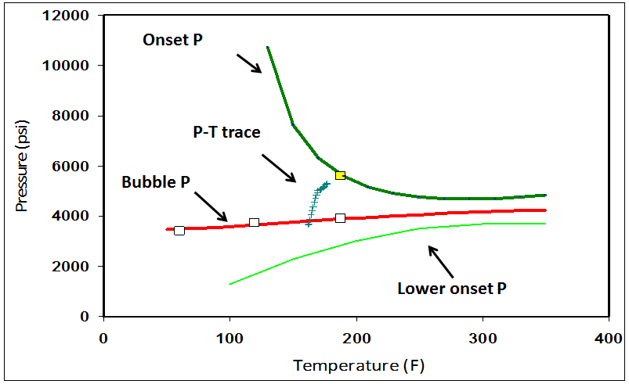
Phase behavior prediction (pipeline)

Slide 23
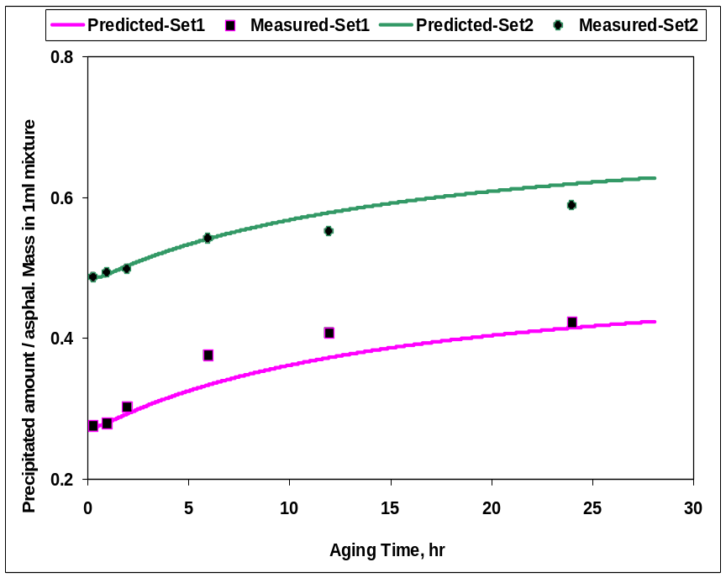
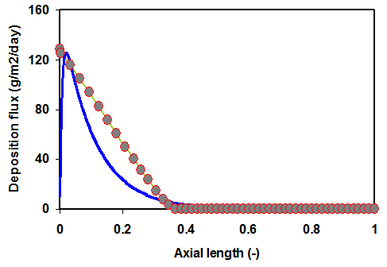
Kinetic parameters
Simulation with fitted k_{d (cap)}
Expt
k_{d(cap)} = 1.43×10⁻³ s⁻¹
k_{p} / s⁻¹ | 1.32×10⁻³
k_{ag} / s⁻¹ | 7.29×10⁻⁵
k*_{d(mom)} | 3.25×10⁻⁶ s⁻¹
k*_{d(lar)} | 1.73×10⁻⁶ s⁻¹
k*_{d(mt)} | 4.50×10⁻⁷ s⁻¹

Slide 24
Simulation results
Boundary layer | Frictional ∆P (Psi)
Momentum | 700
Laminar | 605
Mass transfer | 519
Field data= 648 Psi (28days)

Slide 25
Summary
    ADEPT simulator can successfully predict the asphaltene deposition in wellbore/pipeline.
    Onset pressure and bubble pressure increases significantly with GOR increases, but the effects on lower onset pressure can be neglected;
    Deposit location changes with GOR.

Slide 26




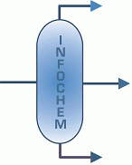




Acknowledgments
Jeff Creek
Jianxin Wang
Andrew Yen
Sai Panuganti
Jill Buckley
Vargas Francisco

